Slide 1
Research Data Support
August 2013
Valerie McCutcheon, Research Information Manager
Notes:
GU work and demo of registry

Slide 2
Research Data Management Support
Make it easy for researchers
Much does not apply to you?
You’ve got it sorted already?
We want you be aware of what is happening
You might want to utilise some of the support offered
You might have some great ideas from your experience that can help with generic University plans
Notes:
1

Slide 3




Do open access requirements apply to my work?
Yes
Policy intent towards open access of research outputs. Listened to researcher views on complexities - no formal requirement yet
Good Research Practice, FoI, DP
After REF - Possibly

Slide 4
Funder Acknowledgement
All papers must include acknowledgement of the funding that supported the research. Recommended format 'This work was supported by the Natural Environment Research Council [grant number xxx]‘
‘This research received no specific grant from any funding agency in the public, commercial, or not-for profit sectors.’
A list of standard names for major UK research funders is available at:
http://www.rin.ac.uk/our-work/research-funding-policy-and-guidance/acknowledgement-funders-journal-articles
RCUK mandate inclusion of funder reference
      ACTION: Encourage inclusion of funding reference in papers
Notes:
Multiple grant references can be separated by comma space, or where several agencies a semi-colon and the word ‘and’

Slide 5
Publicly Funded Work
Papers should also include a statement on how the underlying research materials - such as data, samples or models – can be accessed. It is not necessary that the data itself be openly accessible if there are compelling reasons against this
RCUK mandate
Lord Kelvin doesn’t work there now?
      ACTION: Encourage inclusion of a dataset reference in papers

Slide 6
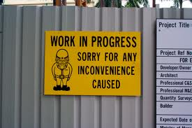
Pilot Study
Survey/Interviews
Advocacy
Research
Report to RPSC Sept2013
EPSRC deadline May 2015
Notes:
British Library may have some useful case studies available soon which may help with advocacy.
Make it easy for researchers
5

Slide 7
Plans
Provide data storage for those who need it
Provide more advice and support (e.g. DMP’s, integrating data management into workflows)
Links to publications and on web profile – all your outputs together
Seek clarification of requirements
Notes:
British Library may have some useful case studies available soon which may help with advocacy.
6

Slide 8
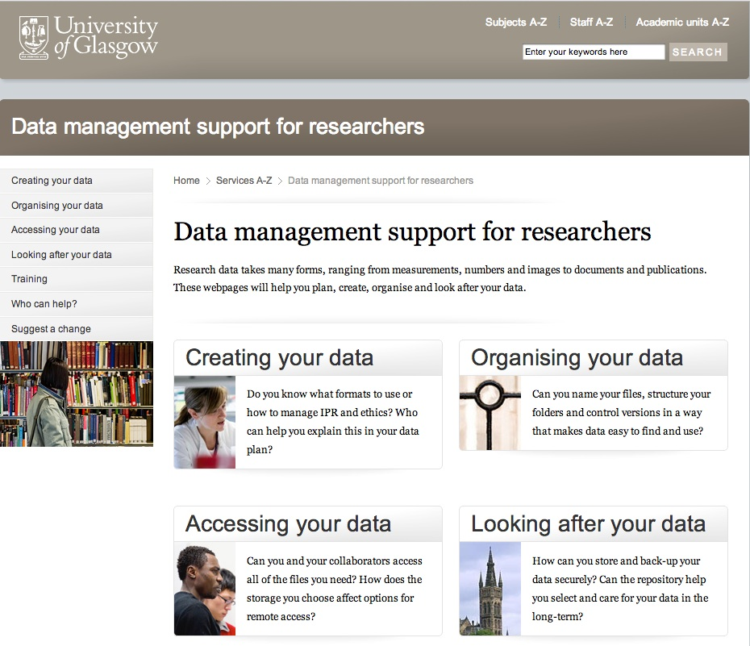
http://www.gla.ac.uk/services/datamanagement/

Slide 9
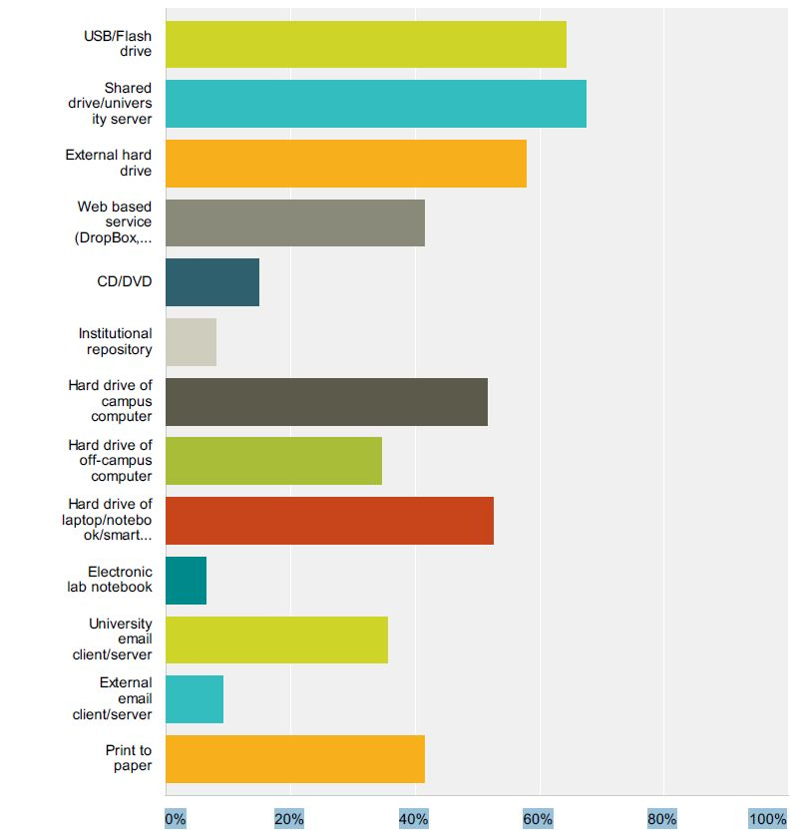
Data Registry
LIVE JANUARY 2013
        DataCite
        Linked data storage
        Plan to link to national registry
        (resource access and visibility)
        ORCID (open researcher and
        contributor ID)
        ePrints standardisation (ReCollect)
Notes:
ORCID = Open Researcher and Contributor ID. Helps distinguish and aggregate research outputs from others with similar names – it is global. It will help transfer data between organisations. We hope to be able to provide a range of services to academics. ODIN project is looking at interoperability of ORCID and DataCite http://odin-project.eu/
DataCite. Robust data storage. Simple and clean metadata schema. Digital Object Identifier (DOI) per collection (not file). New version needs new DOI. Includes advice on citation.
8

Slide 10
Metadata
Title of dataset
Creator/s
Publisher e.g. University of Glasgow
Original Publication URL
Publication Date of dataset
Notes:
9

Slide 11
Digital Object Identifier Service
Available Soon
Some journals require
Allows the impact of data to be tracked
Glasgow format
‘10.XXXX/gla.researchdata.2013.29’
http://dx.doi.org/10.5255/UKDA-SN-7106-1
Research-openaccess@glasgow.ac.uk
Notes:
10

Slide 12
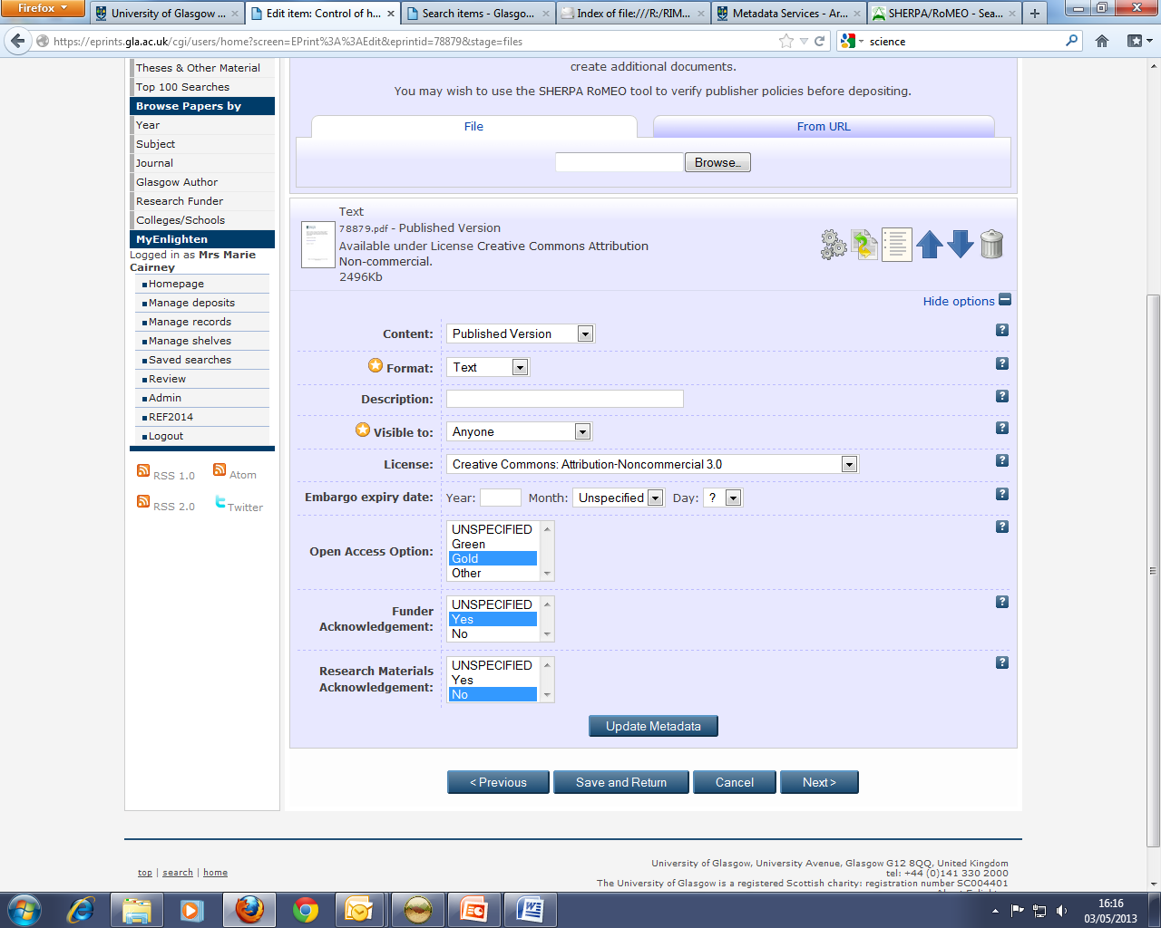
Notes:
This is a back office screen used by the repository team and does not show publicly. Encouraging inclusion of dataset information in papers and checking compliance. It allows us to report to RCUK.
There is a consultation coming out soon via V4OA http://www.v4oa.net/ The outputs from this consultation, along with inputs from the RCUK guidance, will be fed into work being led by CASRAI http://casrai.org/ to document agreement on integrated OA reporting standards and publish that agreement to the online dictionary for research administration data standards (http://dictionary.casrai.org). See blog post http://casrai.org/about/announcements/casrai-uk-working-group-to-advance-integrated-standards-for-open-accessThe objective is a single online registry of such administrative standards in order to simplify implementation and interoperability in common research-supporting software and across organizational, discipline and national boundaries.

Slide 13
What MUST staff do?
Key Actions
        Ensure robust data storage - funders, subject repository, or secure backed up location
        Add a statement on how to access underlying research materials to acknowledgements on papers
        Please tell us your views and raise concerns
        research-openaccess@glasgow.ac.uk
        Early days - don’t panic

Slide 14


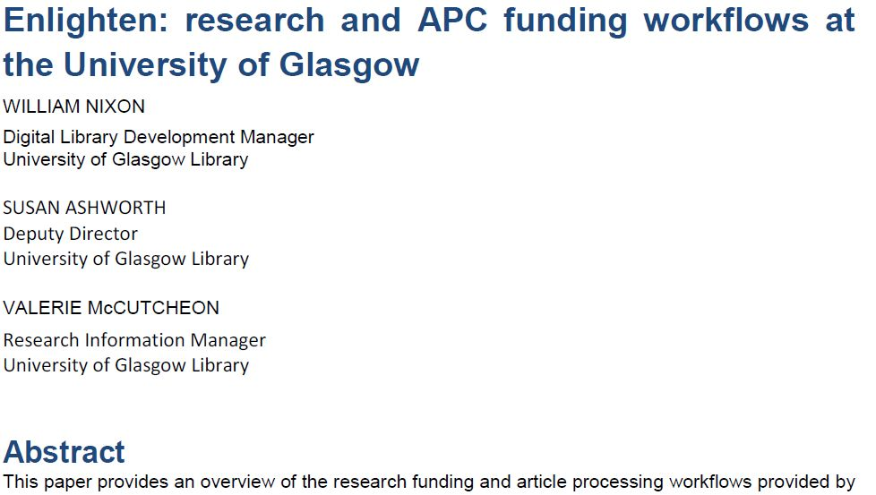
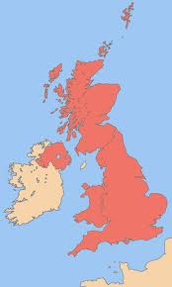

Demo
Your Research Paper
http://researchdata.gla.ac.uk/
Notes:
13

Slide 15
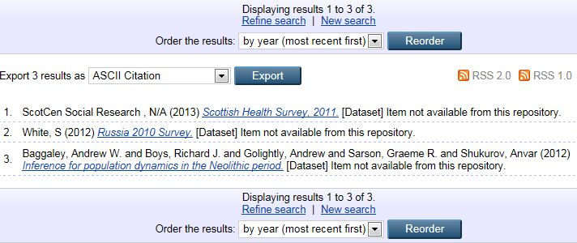
Search For Datasets

Slide 16
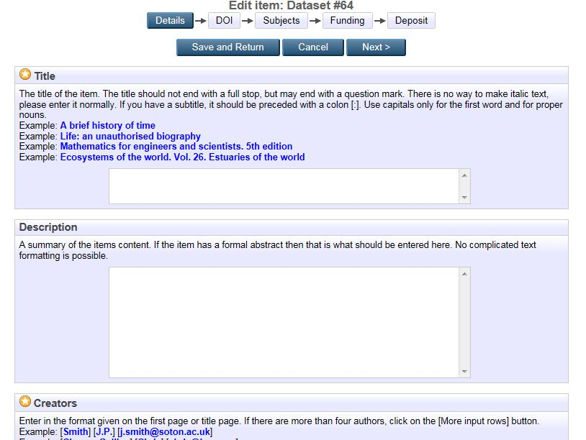

Slide 17
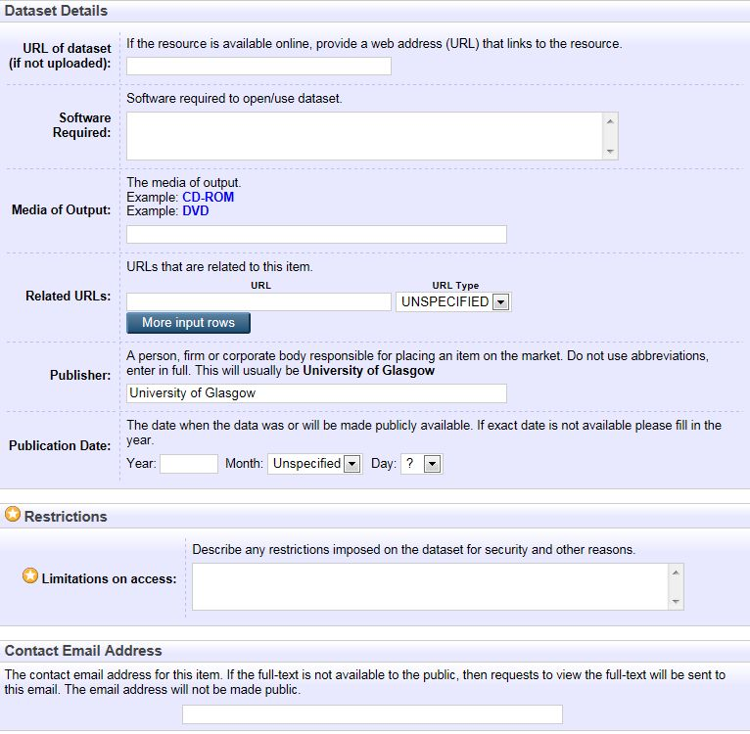

Slide 18
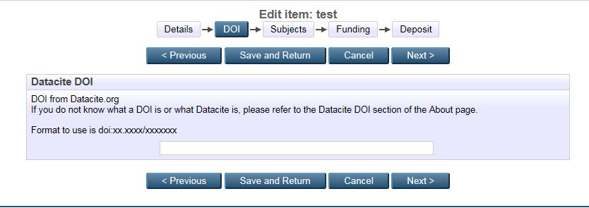
Key Actions
Digital Object Identifier

Slide 19
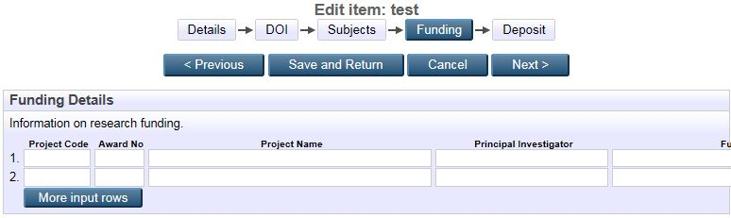
Relate Dataset to Award/s

Slide 20
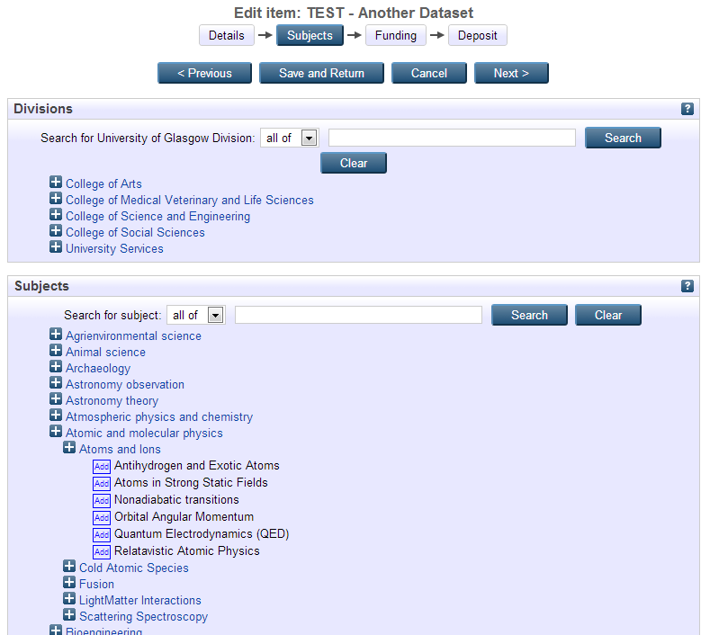
Notes:
Retention dates and extension of these for last data access need to be clearer. May adopt ReCollect approach.

Slide 21
Questions and Suggestions
        research-openaccess@glasgow.ac.uk

Slide 22
Overview of Glasgow Research Related Systems
HR System
Finance System
Research System
Institutional Repository
Student System
Research Mapping System & Web Pages
Research Mapping System & Web Pages

Slide 23
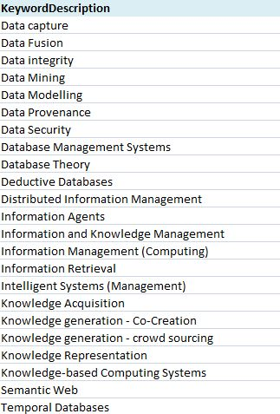
Advertising the Research – What?
RCUK Classifications
        Meaningful (versus Library of Congress)
        Available from RCUK for 1/3 of our awards
Deliver web views
http://academicexpertise.wordpress.com/
Notes:
22

